Slide 1


AdventureWorks Sales Analysis
Excel Based Project
By S KARTHIK

Slide 2
Company Background
•
Global Manufacturer: Adventure Works Cycles is a large multinational bicycle manufacturing company.
•
Product Lines: Manufactures metal and composite bicycles for North America, Europe, and Asia.
•
Headquarters: Bothell, Washington with 290 employees.
•
Operations: Regional sales teams across global markets.
•
Key Acquisition: Acquired a Mexico plant in early 2000s; sole manufacturer of touring bikes since 2001.
•
Strategic Goals: Expand market share, launch online sales, and reduce production costs after a strong fiscal year.

Slide 3





Project Objectives
Data Preparation
Calculation
Visualization
Analyze AdventureWorks sales data in Excel. Clean, prepare, and structure raw data for analysis.
Perform lookups, complex calculations, and aggregations to derive meaningful metrics.
Build KPIs, pivot tables, and interactive charts to generate actionable business insights.

Slide 4

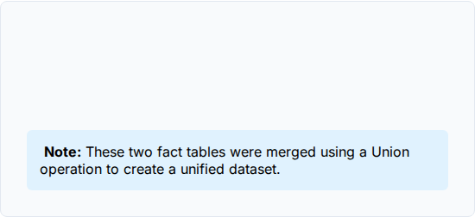
Dataset Overview
Dimension Tables
Fact Tables
•
DimCustomer
•
FactInternetSales
•
DimDate
•
Fact_Internet_Sales_New
•
DimProduct
•
DimProductCategory
•
DimProductSubCategory
•
DimSalesTerritory

Slide 5

Core Tool: Microsoft Excel
•
Data Cleaning: Removing duplicates and errors.
•
Data Preparation: Structuring for analysis.
•
Lookup Functions: VLOOKUP / XLOOKUP.
•
Pivot Tables: Dynamic summarization.
•
Charts & Dashboards: Visual storytelling.
•
KPI Calculations: Measuring success.

Slide 6




Tools Explored for Practice
SQL Server
Power BI
Used for data extraction and joining tables efficiently.
Advanced data modeling and interactive dashboard creation.
Tableau
Building specialized and aesthetic visualizations.
*Used for proficiency building, not the main project.

Slide 7
Data Preparation Tasks
Data Structure & Lookups
Calculated Fields
Union of Fact Internet Sales tables
Derived: Year, Month, Quarter, Weekday
Lookup Product Name (DimProduct → Sales)
Financial Month & Financial Quarter
Lookup Customer Full Name (DimCustomer → Sales)
Sales Amount = Unit Price × Order Quantity - Discount
Lookup Unit Price (DimProduct → Sales)
Production Cost = Unit Cost × Order Quantity
Created proper Date field from OrderDateKey
Profit = Sales Amount – Production Cost

Slide 8


Date Intelligence Summary
Standard Calendar
Operational Dates
•
Year
•
Weekday No
•
Month No
•
Weekday Name
•
Month Full Name
•
Financial Month
•
Quarter (Q1–Q4)
•
Financial Quarter
•
Year-Month (YYYY-MMM)

Slide 9







Key Performance Indicators
Sales Amount
29.36M
Profit
12.08M
Profit %
41.1%
Total Orders
6K
Total revenue generated from all orders.
Net earnings after production costs.
Profit margin efficiency.
Volume of successful transactions.
Production Cost
17.28M

Slide 10
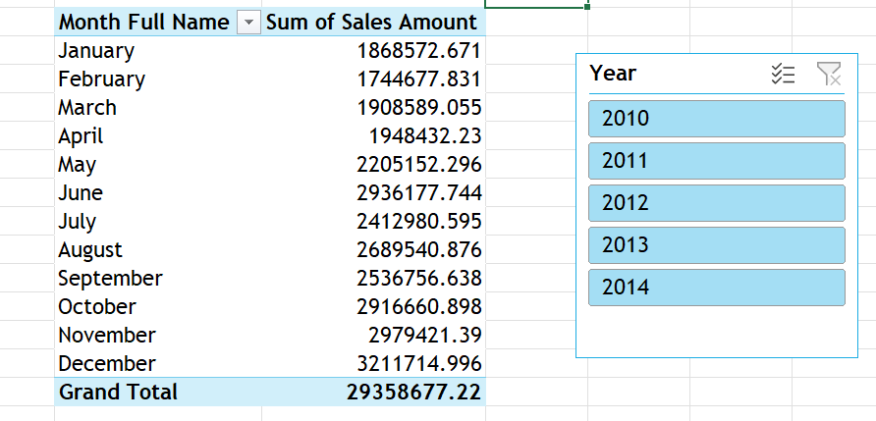

Pivot Table Analysis
Month vs Sales Analysis
A core part of the analysis involved creating dynamic pivot tables to understand temporal trends.
Rows: Month Name
Values: Sum of Sales Amount
Filters: Year
Goal: Identify seasonal sales spikes and dips.

Slide 11
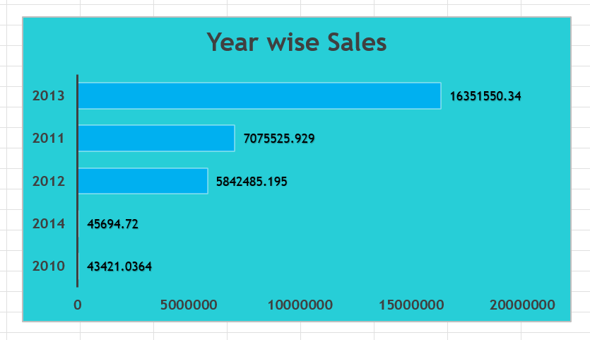
Year-wise Sales Trends
Consistent year-over-year growth indicates successful market expansion strategies.

Slide 12

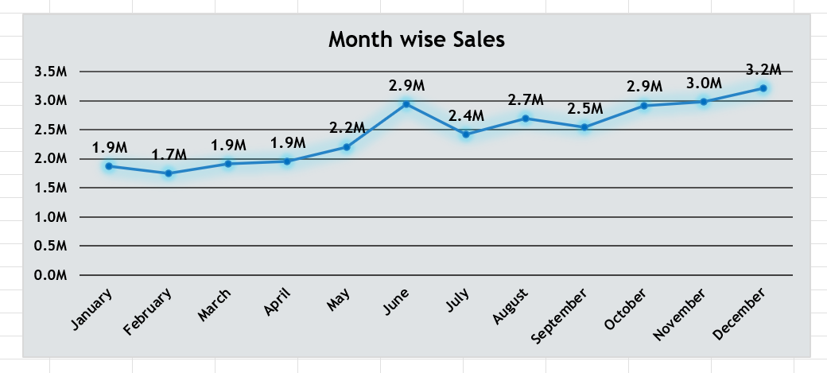
Month-wise Sales Trend
Trend analysis shows peak performance in Q4 (Nov-Dec).

Slide 13
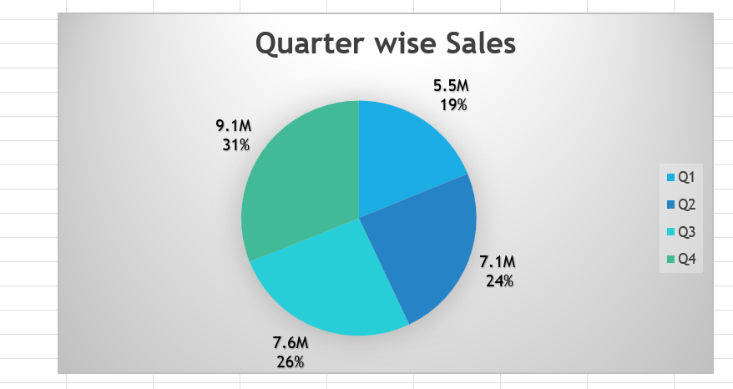
Quarterly Sales Distribution

Slide 14
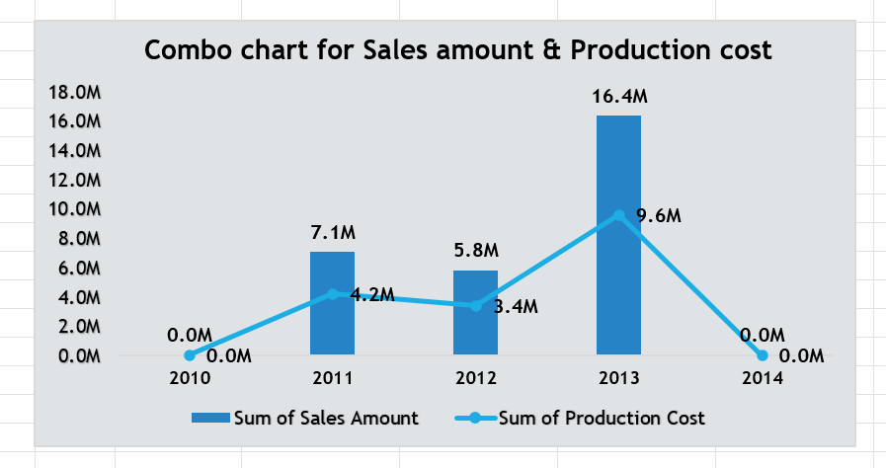
Sales vs. Production Cost
This combo chart visualizes the relationship between gross revenue and production expenses.
•
Bars: Represent Total Sales Amount.
•
Line: Represents Total Production Cost.
•
Insight: The gap between the bar and line represents the gross profit margin. We observe margins tightening in Q2 due to supply chain costs.

Slide 15
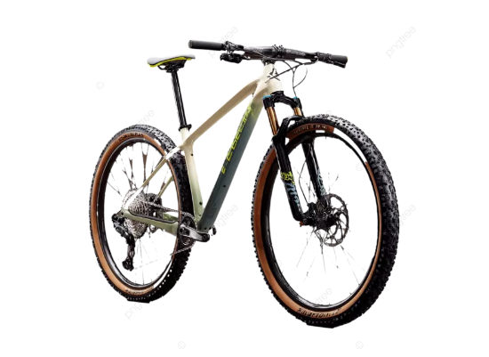
Product Performance
Category Insights
Bikes: Highest revenue contributor with 28.32M in sales but lower profit margins per unit (11.51M).
Accessories: Best volume-to-margin ratio
— 0.70M in sales and 0.44M in profit.
Clothing: High margin with seasonal demand spikes — 0.34M in sales and 0.14M in profit.

Slide 16
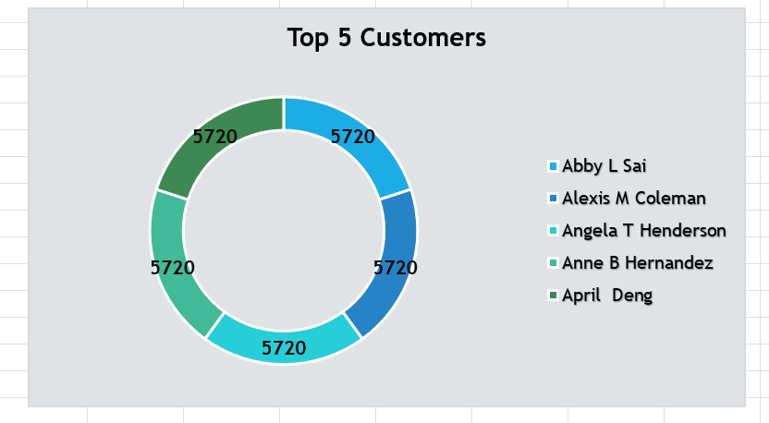
Customer Performance

Slide 17
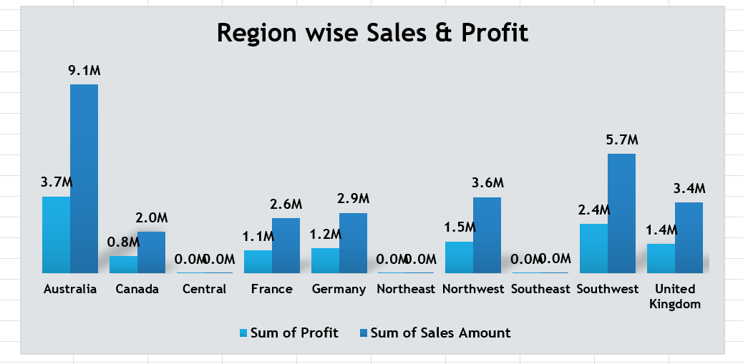
Regional Performance
Best Performing Region: North America
Growth Opportunity: Pacific

Slide 18
Executive Dashboard
A comprehensive view of business health, integrating all key metrics into a single interface.
•
Sales KPIs: Immediate visibility on revenue.
•
Trends: Year-Month performance lines.
•
Breakdowns: Category and Region filters.
•
Rankings: Top products and customers tables.

Slide 19
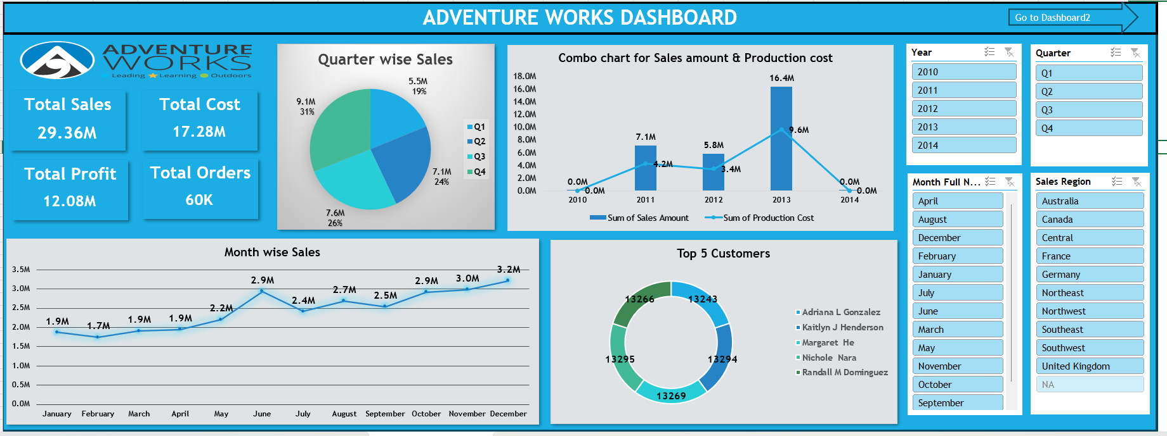
Dashboard-1

Slide 20
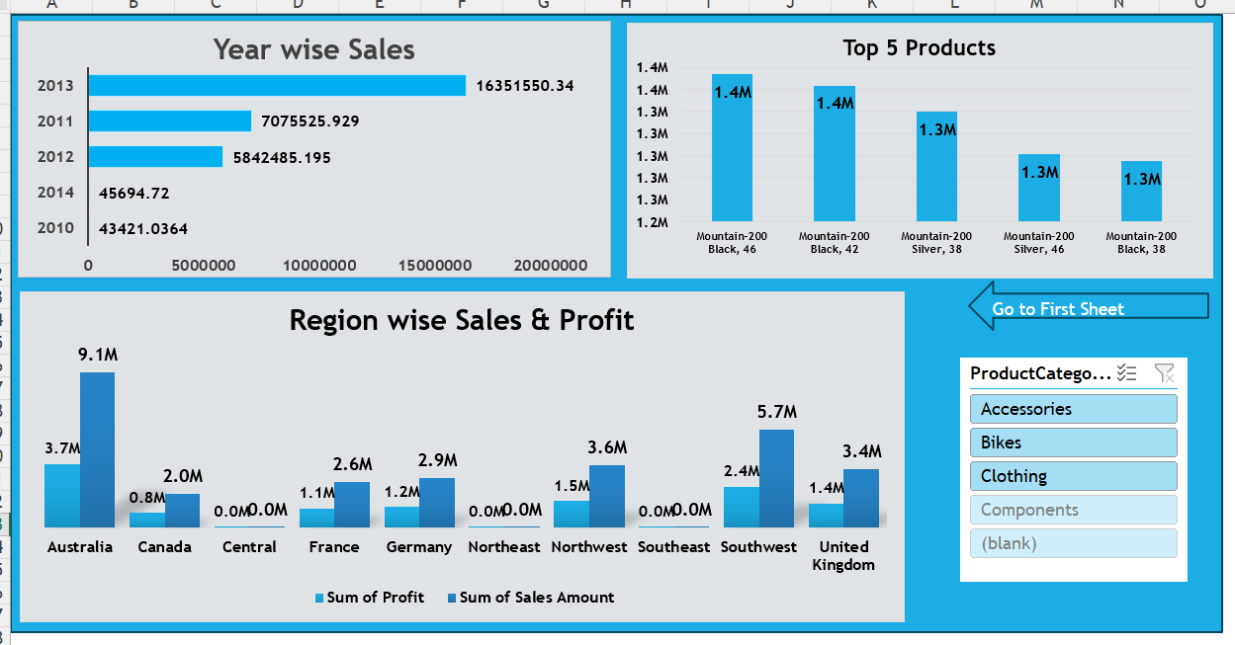
Dashboard-2

Slide 21
Key Insights
Revenue Driver: Bikes contribute the highest total revenue, acting as the company's backbone.
Seasonality: Q3 and Q4 are consistently strong seasons, likely due to holiday sales and end-of-year clearances.
Market Dominance: Australia dominates sales volume, Southeast and Central Regions are the less sales.
Margin Alert: Bikes, Accessories, and Clothing show strong margins now , monitoring ensures profitability remains stable across categories.

Slide 22

Conclusion
Excel-based analysis revealed valuable business trends.
Provided strong visibility of products, customers, and regions.
Supports future decision-making and strategic growth initiatives.

Slide 23

Thank You!

